Slide 1
Healthcare:2D analytics of CT scan data
Done by John Justin Kattakayam
Gopika S S
Shreyansh Jaiswal

Slide 2
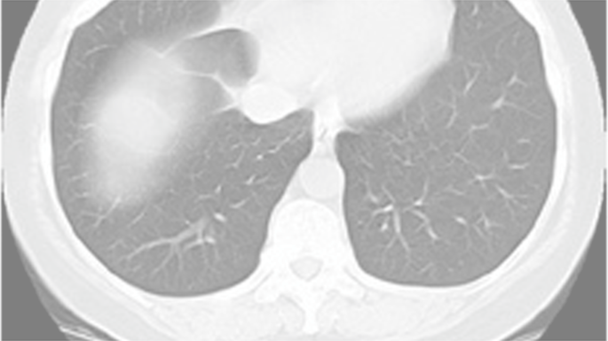
Problem Statement: Investigate the use of texture analysis and feature extraction techniques in CT scan images to identify unique radiomic signatures of COVID-19 infection
.

Slide 3
Introduction
This project is a comprehensive package for COVID-19 detection, comprising three tasks: COVID-19 Infection Segmentation, COVID-19 Classification, and Lung Segmentation. This project aims to provide a complete solution for COVID-19 detection, leveraging the strengths of deep learning models in medical image analysis. By integrating these tasks, the project enables accurate and efficient diagnosis of COVID-19, facilitating timely treatment and improving patient outcomes. Furthermore, the project's modular design allows for easy adaptation and extension to accommodate emerging trends and advancements in medical imaging and deep learning.

Slide 4
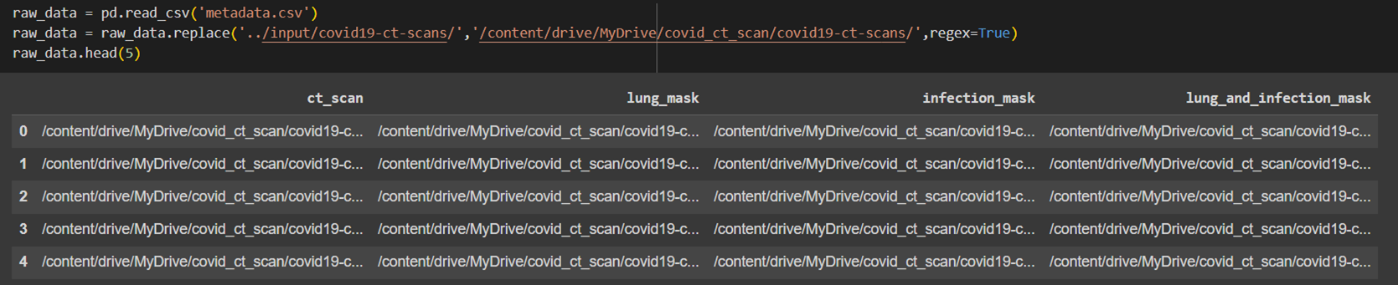
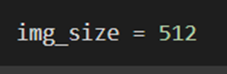
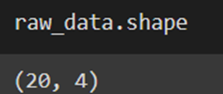
About the Dataset
The project uses a dataset consisting of CT scans and corresponding labels for COVID-19 infection segmentation.
https://www.kaggle.com/datasets/andrewmvd/covid19-ct-scans

Slide 5
Sample Data and Preprocessing
The preprocessing stage involves the following steps:
Removing incomplete and faulty images.
Separating model for empty mask prediction.
Contrast Limited Adaptive Histogram Equalization (CLAHE) for image enhancement.
Cropping the Region of Interest (ROI) using Otsu's binarization and other approaches
Data augmentation

Slide 6
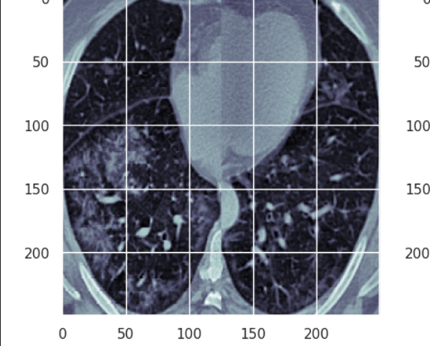
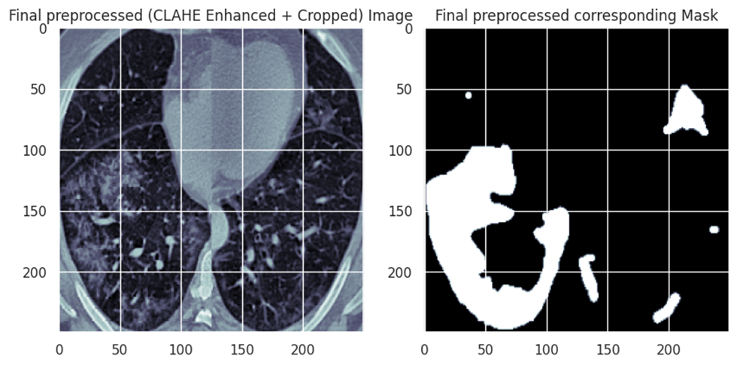
CLAHE(Contrast Limited Adaptive Histogram Equalization ) for image enhancement

Slide 7
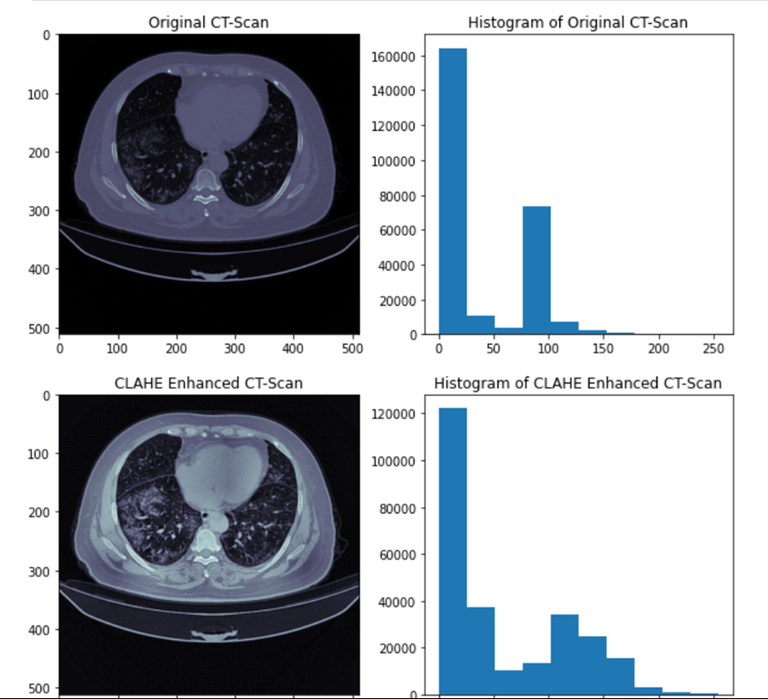
Enhancement

Slide 8
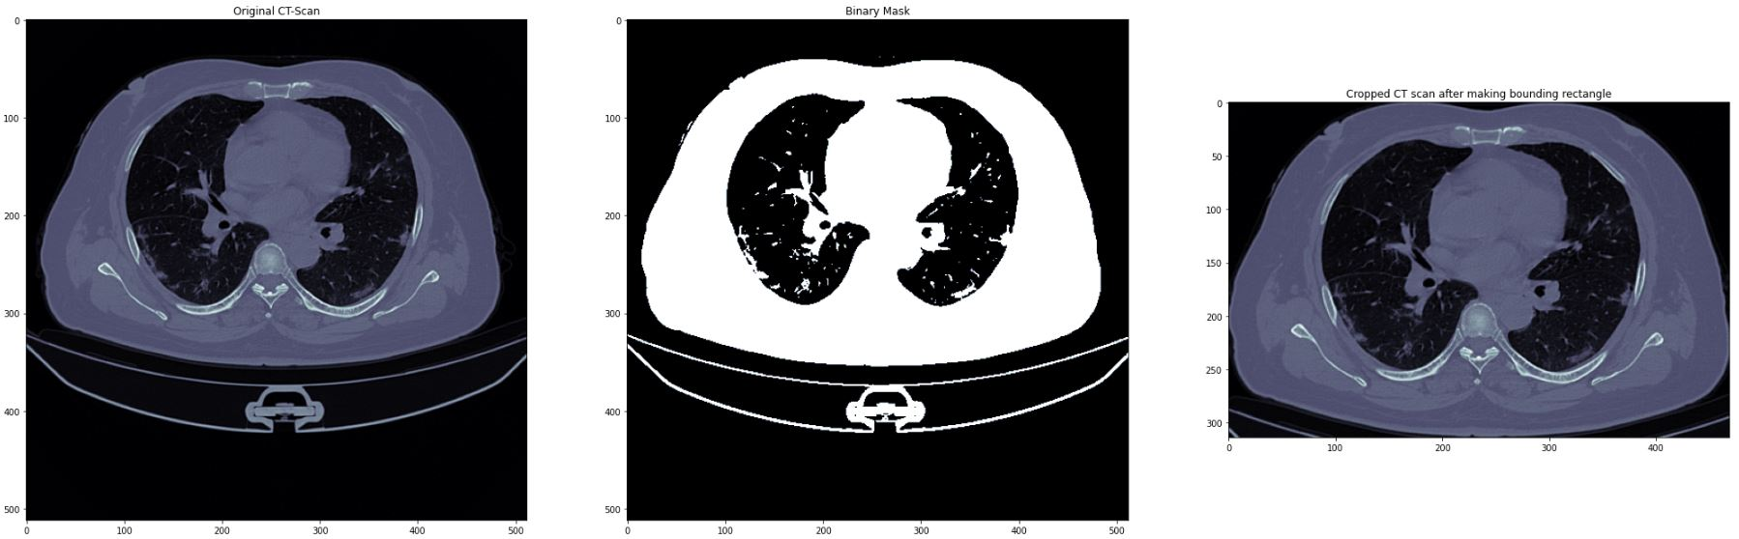
Cropping the Region of Interest (ROI) using Otsu's binarization and other approaches

Slide 9
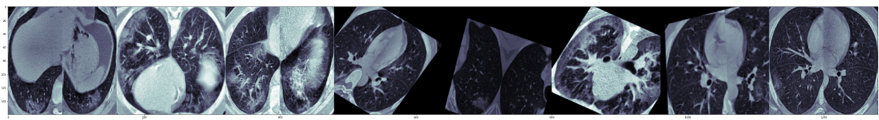
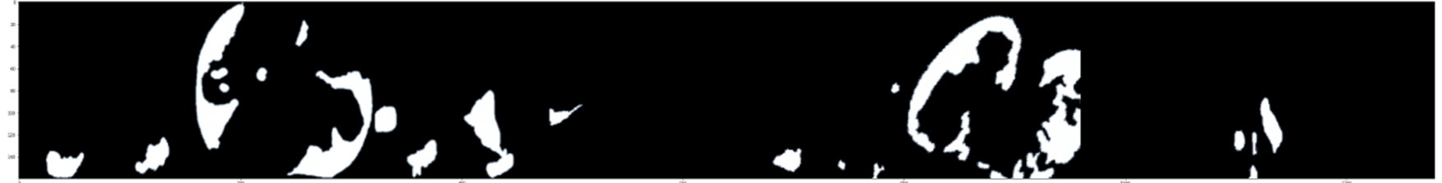
Data Augmentation

Slide 10
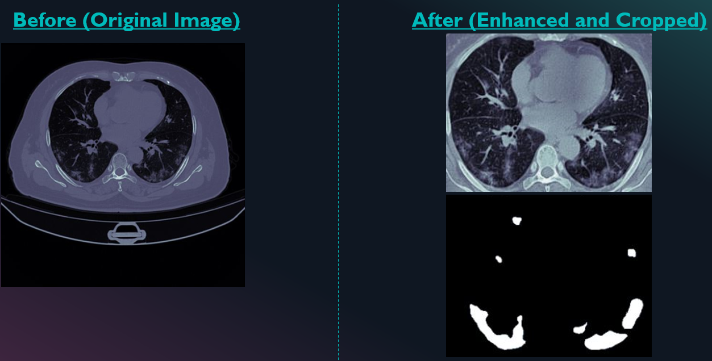
Before and After Preprocessing

Slide 11
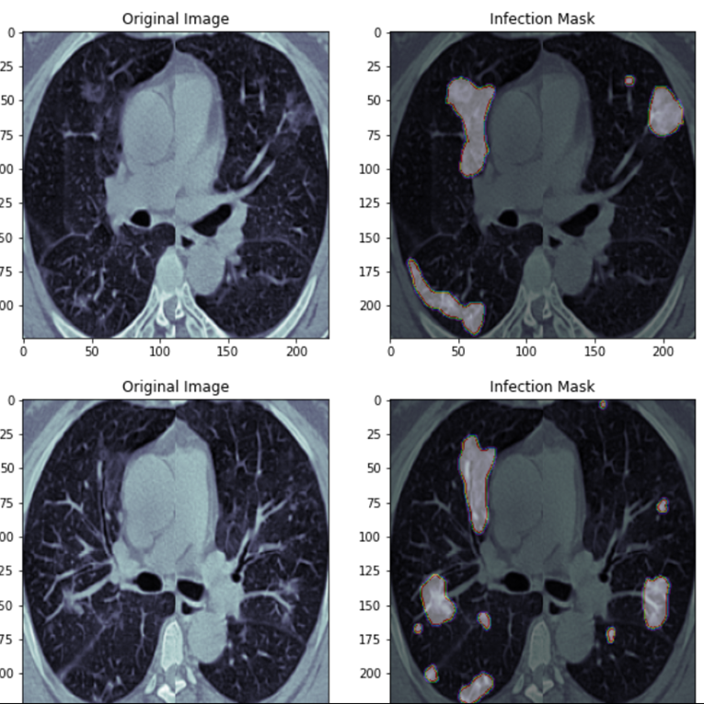
Infection Masing on top of the whole image for better analysis

Slide 12
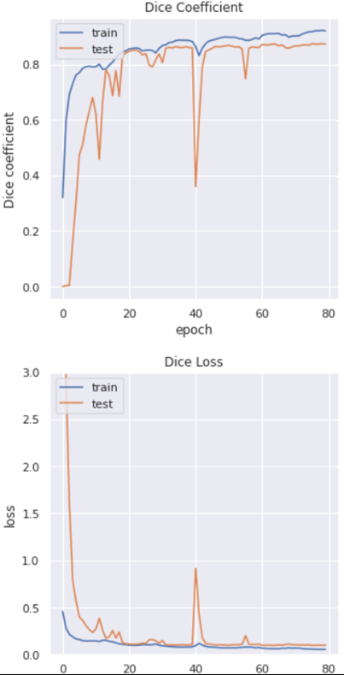

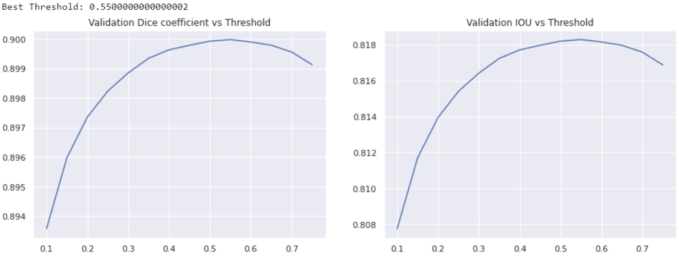
Visualization and model evaluation

Slide 13
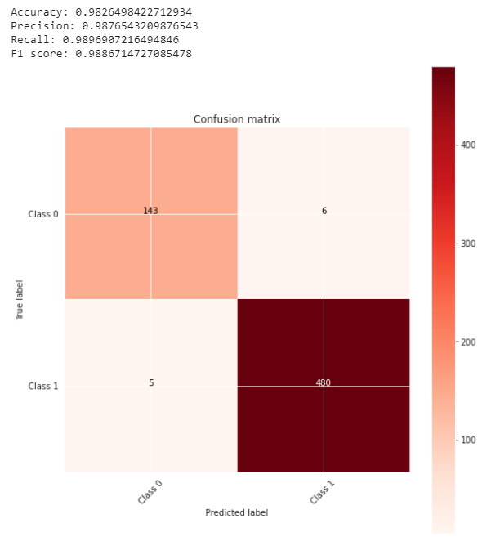
Confusion Matrix

Slide 14
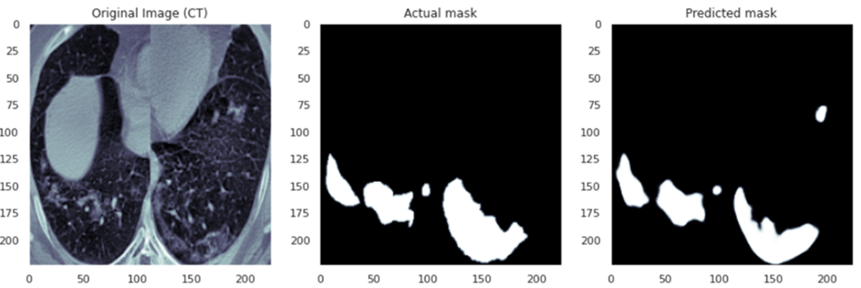
Prediction vs Actual

Slide 15
Conclusion
some set of CT scans belong to a distribution that is easy to segment between infection and background while other CT scans are belonging to a distribution that is not easy to segment between infection and the background.
Done it with one sample, it is not thoroughly investigated.
2 parts, one good and easily segmentable and the other bad (tough to segment).
And fit models separate and find the output.

Slide 16
Team Roles and Responsibilities
Shreyansh:
Model research and implementation
Testing
PPT
John:
Preprocessing and data extraction
PPT
Evaluation Metrics
Gopika:
Visualization and Data Augmentation
PPT
Evaluation Metrics

Slide 17
THANK YOU!

